Slide 1
Digital Pet Task App
Team Members: Sarah Jorissen, Laura Lopez, Jonathon Hoffman

Slide 2
Abstract
The Digital Pet Task App helps to incentivize the user to stay productive and on task by tying the care of the pet to a to-do list. If tasks are finished in a timely manner, the pet will be fed & cared for, and continue to grow. However, neglecting your tasks also means neglecting your pet, which will eventually lead to its death, and starting all over again.

Slide 3
What will be covered
We will be briefly covering the most important requirements for the Digital Pet Task App, those requirements will revolve around the:
Authentication System
Task List System
Calendar System
Pet System

Slide 4
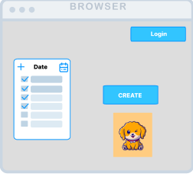
Authentication System Requirements
Create account
Log into existing account
Username/Password Combination
Password requirements

Slide 5
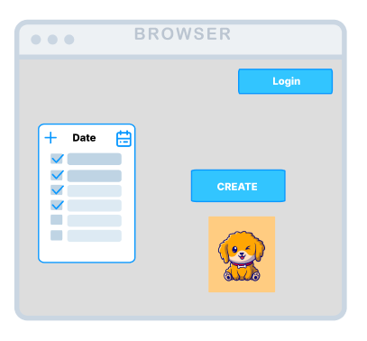
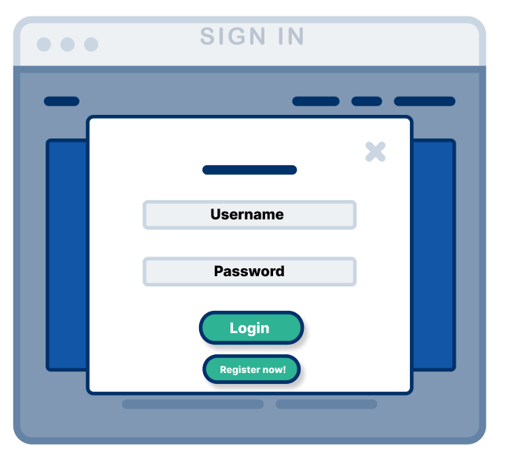
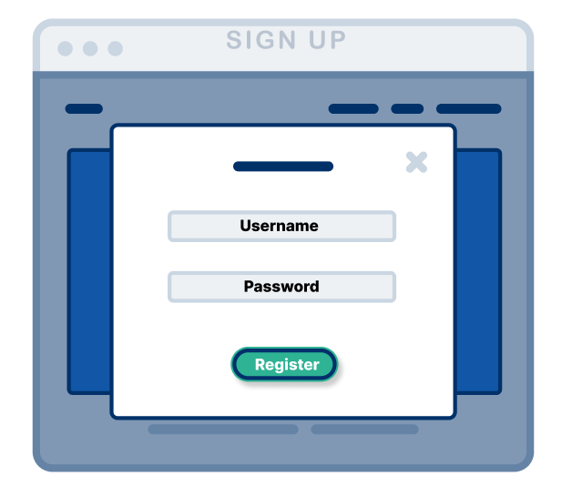
Process for signing up
The User will click the “Login” button where they will be directed to the Login pop up window
There will be a “Sign-up” button at the bottom of the Login pop up window

Slide 6
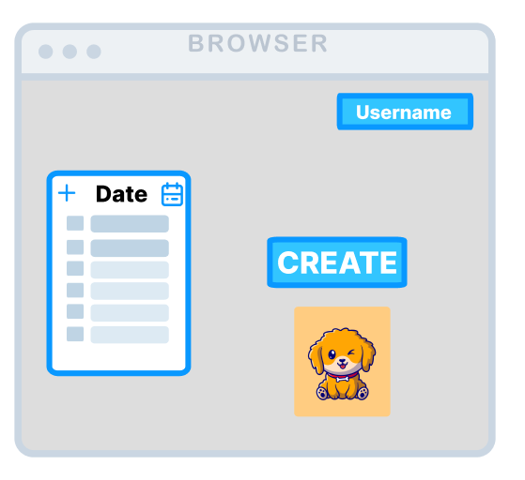
Process for Login
The User will click the “Login” button where they will be directed to the Login pop up window

Slide 7
Task List System Requirements
Add a task
Check off a task
View a task
Scroll through tasks
View/open calendar
General Mock-Up of Web Browser

Slide 8
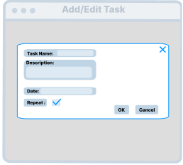
Add/Edit Task Window
Appears upon clicking “+” icon on task list window

Slide 9
Calendar System Requirements
View Calendar
View Tasks on Calendar by specific date
Edit Tasks on a specific date
Add Tasks on a specific date

Slide 10
View Calendar
There will be a symbol on the main page of the project to open the calendar

Slide 11
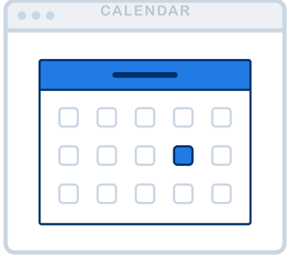
View Calendar Cont.
After clicking the calendar button on the task list, the user will see a calendar generated into a pop up window.
The user will be able to:
Change this view from a weekly to a monthly view or vice versa
Click on dates to see associated task list

Slide 12
View tasks on a specific date
If the user wishes to see tasks on a specific date, they can just click that date and the associated task list will generate.

Slide 13
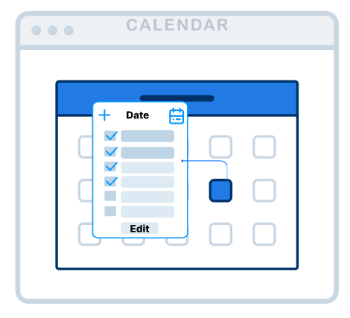
View tasks on a specific date Cont.
After clicking the desired date, the task list associated will generate and look like this.
The user will see:
The task list associated with the date
An option to add a task to the list
An option to edit the task list

Slide 14
Edit a task from the Calendar
If the user wishes to change some details regarding that specific dates task list, they can click the “Edit” button.

Slide 15
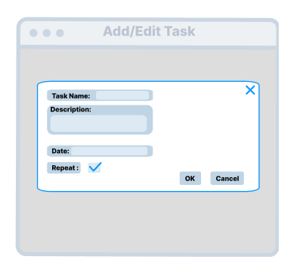
Edit a task from the Calendar Cont.
After clicking the “Edit” button the user will see a window pop up that shows the user the current task list, where they can edit:
The name
Description
Date
Whether its repeating
There will be additional options, “OK” and “Cancel” which will either finalize changes or cancel the process respectively.

Slide 16
Add a task to the Calendar
If the user wishes to add some details regarding that specific dates task list, they can click the “+” button.

Slide 17
Add a task to the Calendar Cont.
After the user clicks the “+” button, it will lead to the Add task window, which looks similar to the Edit task window.
The user will be able to:
Name the task
Give a description of the task
Specify the date the task will occur
Mark whether the task repeats or not
Where there will be two additional options, “OK” and “Cancel”, that Confirms the new task or cancels the operation respectively.

Slide 18
Settings System
The Settings system will include a variety of options for reminders:
When the user has an upcoming task
When there is an upcoming expiration date for a task
The pet’s overall health (happiness/deterioration)

Slide 19
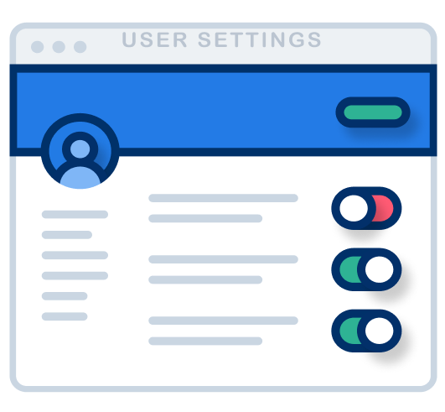
Process of accessing the settings
The user will be able to access the settings window by clicking their “Username” button in the top right corner
Afterwards a window with the various options will be listed with toggles the User can switch to on and off

Slide 20
Pet System Requirements
Creating a pet
The pet view
Pet Variety
Pet Customization

Slide 21
Creating a pet
New users will click the button that allows them to create their pet
Once created, the user will be prompted to give them a name, and then will be sent back to the main screen, where they can now see their new pet
If the pet dies, the user will see a little gravestone alongside a button to create a new pet and start over

Slide 22
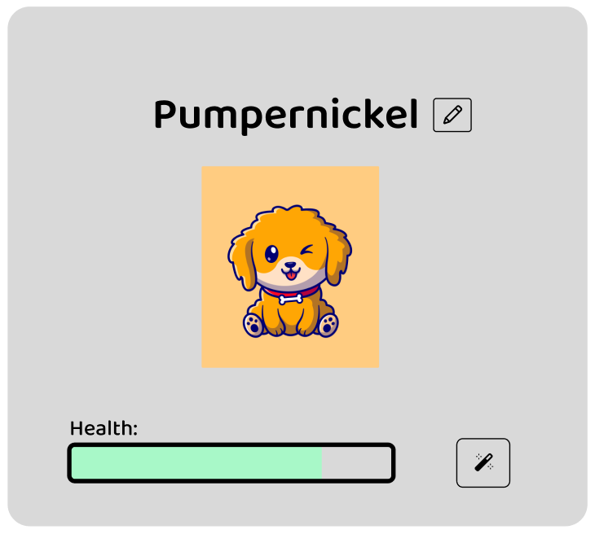
Pet View
The pet’s appearance will change based on its age and current status
Three life stages: child, adolescent, adult
Name given by user will be displayed, alongside an option to change it
Health bar shows pet’s current status based on user’s activity (or lack thereof)

Slide 23
Pet Variety
Pet can randomly grow into 5 different kinds once it reaches adulthood
With continued care of their adult pet, user will unlock the option to change to a different pet type

Slide 24
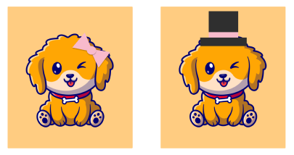
Pet Customization
Different accessories can be unlocked over time
Pet can wear more accessories as it gets older
Different colors can be unlocked, allowing the user to change their pet’s color whenever they want

Slide 25
In Summary
The Digital Pet Task app will have an array of features that are divided up into several categories:
The Authentication System
The Task List System
The Calendar System
The Settings System
The Pet System

Slide 26
That’s all folks! :)
Feel free to ask any questions!

